Slide 1
Cell Association
Cell association is referred with different terms in the literature:
  cell selection
  cell-site selection
  cell assignment
  BS assignment
  user association
It is a function that finds suitable BSs for serving user equipments (UEs) according to some given criteria

Slide 2
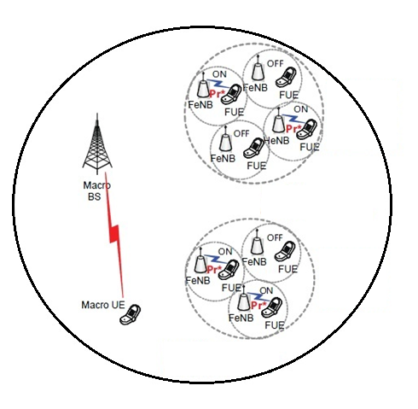
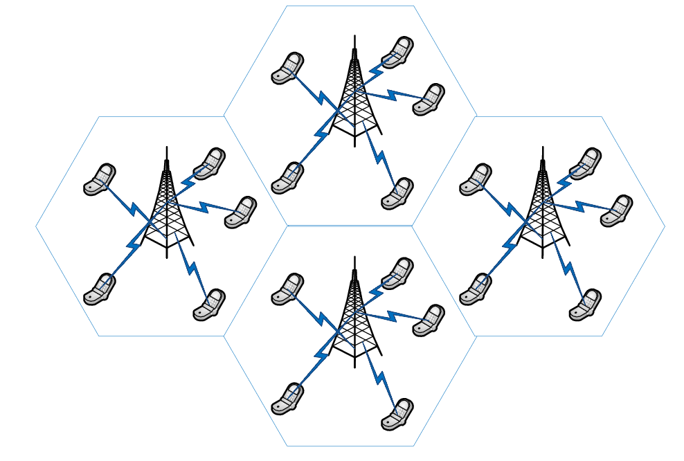
Cell Association
a) In homogeneous network
b) In heterogeneous network

Slide 3
Cell Association
Access Control Mechanisms
  Closed access mode
  Open access mode
  Hybrid access mode

Slide 4
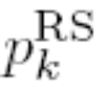
Cell Association
Reference Signal Received Power (RSRP)-Based Scheme
  In the reference signal received power (RSRP)-based cell-association scheme, each BS iteratively broadcasts a reference (pilot) signal
  Let denotes the power level of reference signal sent by the BS k in downlink transmission.
  Each UE i measures the received power level from the reference signal transmitted by any of its nearby BSs which is called the reference signal received power (RSRP)

Slide 5

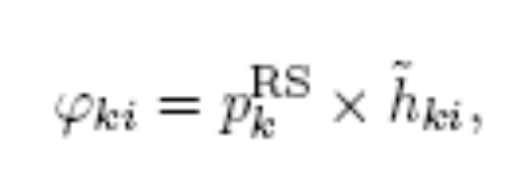
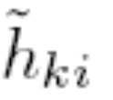
Cell Association
Reference Signal Received Power (RSRP)-Based Scheme
  Let denote the RSRP measured by UE i from the BS k by ; that is given by
  where denotes the power level of reference signal sent by the BS k in downlink transmission, and denotes the downlink path-gain from the BS k toward UE i

Slide 6

Cell Association
Reference Signal Received Power (RSRP)-Based Scheme
  In RSRP-based cell-association scheme, the UE $i$ selects its cell with maximum RSRP as follows:

Slide 7
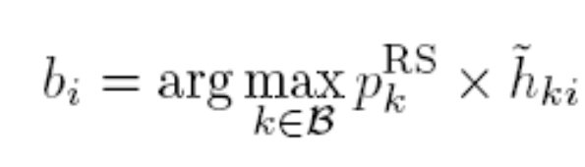

Cell Association
There are two main traditional cell association schemes
  Reference Signal Received Power (RSRP)-Based Scheme:
  Signal-to-Interference-Plus Noise Power Ratio (SINR)-Based Scheme
  Reference Signal Received Quality (RSRQ),
    It is used for cell selection in LTE single-tier networks, which is similar to SINR-based scheme

Slide 8
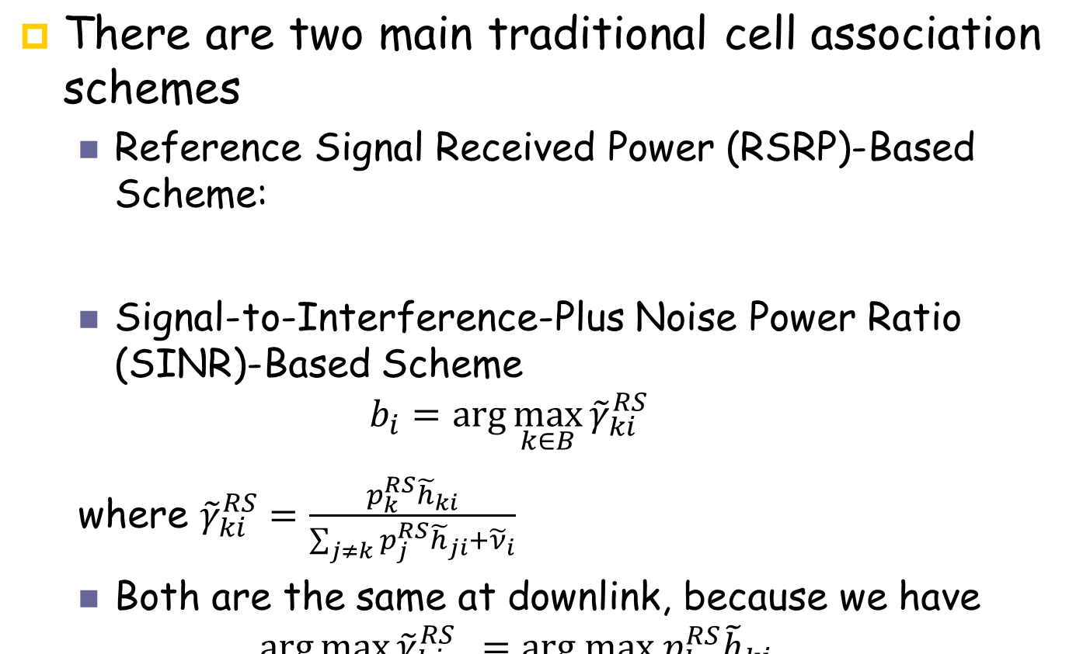
Cell Association

Slide 9
Load Balancing
Using Traditional Cell Association Schemes in Heterogeneous Networks cause the following problems
  Load Imbalance among Different Tiers
  Intensified Inter-cell Interference

Slide 10
Load Balancing
The key metric for performance and users’ satisfaction is their actual achievable data rate rather than SINR and received power

Slide 11
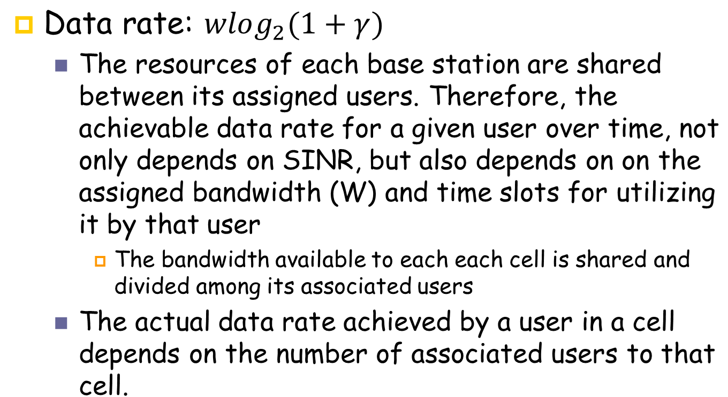
Load Balancing

Slide 12
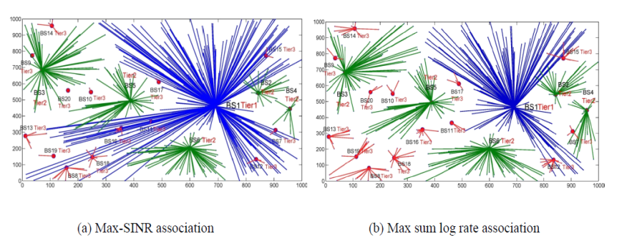
Load Balancing
Due to large difference in the transmission power of BSs of different tiers,
  Small BSs will often be lightly loaded since macrocell BS coverage will be much larger than that of small BSs.

Slide 13
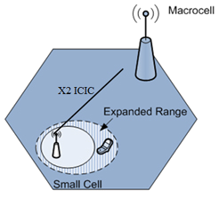
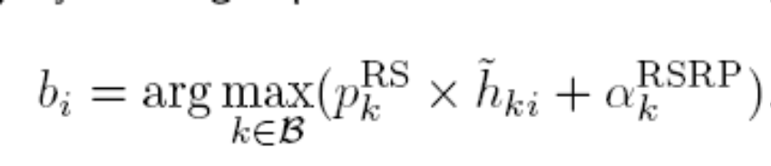
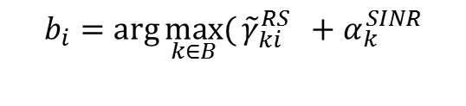
Load Balancing
A Solution for the problem of load imbalance in the downlink
    Bias-Based Cell Range Expansion (CRE)
      RSSP-based CRE:
      SINR-based CRE:

